Slide 1
CHAPTER 3
SUPERVISED LEARNING NETWORK
“Principles of Soft Computing, 2nd Edition”
by S.N. Sivanandam & SN Deepa
Copyright © 2011 Wiley India Pvt. Ltd. All rights reserved.

Slide 2
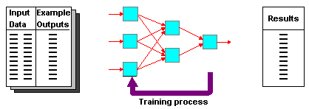
DEFINITION OF SUPERVISED LEARNING NETWORKS
  Training and test data sets
  Training set; input & target are specified
“Principles of Soft Computing, 2nd Edition”
by S.N. Sivanandam & SN Deepa
Copyright © 2011 Wiley India Pvt. Ltd. All rights reserved.

Slide 3
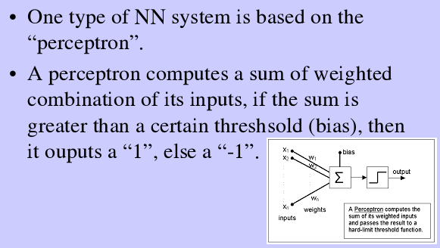
PERCEPTRON NETWORKS
“Principles of Soft Computing, 2nd Edition”
by S.N. Sivanandam & SN Deepa
Copyright © 2011 Wiley India Pvt. Ltd. All rights reserved.

Slide 4
  Linear threshold unit (LTU)
x₁
w₁
w₀
w₂
x₂
Σ
o
.
.
.
^{n}
Σ w_{i} x_{i}
w_{n}
_{i=0}
x_{n}
^{n}
1 if Σ w_{i} x_{i} >0
f(x_{i})=
-1 otherwise
{
_{i=0}
“Principles of Soft Computing, 2nd Edition”
by S.N. Sivanandam & SN Deepa
Copyright © 2011 Wiley India Pvt. Ltd. All rights reserved.

Slide 5
PERCEPTRON LEARNING
w_{i} = w_{i} + Δw_{i}
Δw_{i} = η (t - o) x_{i}
where
t = c(x) is the target value,
o is the perceptron output,
η Is a small constant (e.g., 0.1) called learning rate.
If the output is correct (t = o) the weights wi are not changed
If the output is incorrect (t ≠ o) the weights wi are changed such that the output of the perceptron for the new weights is closer to t.
The algorithm converges to the correct classification
  if the training data is linearly separable
  η is sufficiently small
“Principles of Soft Computing, 2nd Edition”
by S.N. Sivanandam & SN Deepa
Copyright © 2011 Wiley India Pvt. Ltd. All rights reserved.

Slide 6
LEARNING ALGORITHM
Epoch : Presentation of the entire training set to the neural network.
In the case of the AND function, an epoch consists of four sets of inputs being presented to the network (i.e. [0,0], [0,1], [1,0], [1,1]).
Error: The error value is the amount by which the value output by the network differs from the target value. For example, if we required the network to output 0 and it outputs 1, then Error = -1.
“Principles of Soft Computing, 2nd Edition”
by S.N. Sivanandam & SN Deepa
Copyright © 2011 Wiley India Pvt. Ltd. All rights reserved.

Slide 7
Target Value, T : When we are training a network we not only present it with the input but also with a value that we require the network to produce. For example, if we present the network with [1,1] for the AND function, the training value will be 1.
Output , O : The output value from the neuron.
Ij : Inputs being presented to the neuron.
Wj : Weight from input neuron (Ij) to the output neuron.
LR : The learning rate. This dictates how quickly the network converges. It is set by a matter of experimentation. It is typically 0.1.
“Principles of Soft Computing, 2nd Edition”
by S.N. Sivanandam & SN Deepa
Copyright © 2011 Wiley India Pvt. Ltd. All rights reserved.

Slide 8
TRAINING ALGORITHM
Adjust neural network weights to map inputs to outputs.
Use a set of sample patterns where the desired output (given the inputs presented) is known.
The purpose is to learn to
    Recognize features which are common to good and bad exemplars
“Principles of Soft Computing, 2nd Edition”
by S.N. Sivanandam & SN Deepa
Copyright © 2011 Wiley India Pvt. Ltd. All rights reserved.

Slide 9
MULTILAYER PERCEPTRON
Output Values
Output Layer
Adjustable
Weights
Input Layer
Input Signals (External Stimuli)
“Principles of Soft Computing, 2nd Edition”
by S.N. Sivanandam & SN Deepa
Copyright © 2011 Wiley India Pvt. Ltd. All rights reserved.

Slide 10
LAYERS IN NEURAL NETWORK
The input layer:
    Introduces input values into the network.
    No activation function or other processing.
The hidden layer(s):
    Performs classification of features.
    Two hidden layers are sufficient to solve any problem.
    Features imply more layers may be better.
The output layer:
    Functionally is just like the hidden layers.
    Outputs are passed on to the world outside the neural network.
“Principles of Soft Computing, 2nd Edition”
by S.N. Sivanandam & SN Deepa
Copyright © 2011 Wiley India Pvt. Ltd. All rights reserved.

Slide 11
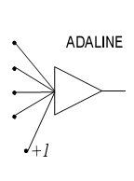
ADAPTIVE LINEAR NEURON (ADALINE)
In 1959, Bernard Widrow and Marcian Hoff of Stanford developed models they called ADALINE (Adaptive Linear Neuron) and MADALINE (Multilayer ADALINE). These models were named for their use of Multiple ADAptive LINear Elements. MADALINE was the first neural network to be applied to a real world problem. It is an adaptive filter which eliminates echoes on phone lines.
“Principles of Soft Computing, 2nd Edition”
by S.N. Sivanandam & SN Deepa
Copyright © 2011 Wiley India Pvt. Ltd. All rights reserved.

Slide 12
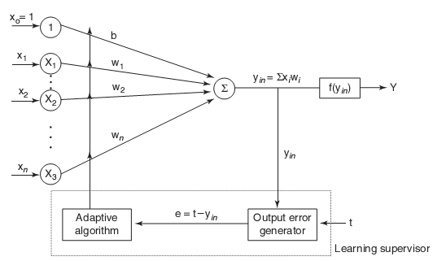
ADALINE MODEL
“Principles of Soft Computing, 2nd Edition”
by S.N. Sivanandam & SN Deepa
Copyright © 2011 Wiley India Pvt. Ltd. All rights reserved.

Slide 13
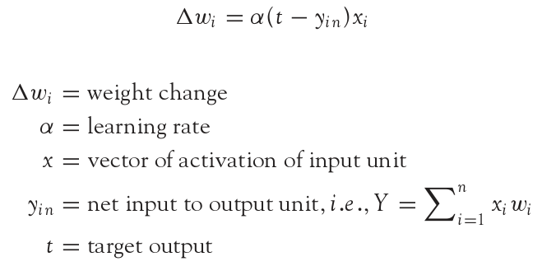
ADALINE LEARNING RULE
Adaline network uses Delta Learning Rule. This rule is also called as Widrow Learning Rule or Least Mean Square Rule. The delta rule for adjusting the weights is given as (i = 1 to n):
“Principles of Soft Computing, 2nd Edition”
by S.N. Sivanandam & SN Deepa
Copyright © 2011 Wiley India Pvt. Ltd. All rights reserved.

Slide 14
USING ADALINE NETWORKS
Initialize
Assign random weights to all links
Training
  Feed-in known inputs in random sequence
  Simulate the network
  Compute error between the input and the output (Error Function)
  Adjust weights (Learning Function)
  Repeat until total error < ε
Thinking
  Simulate the network
  Network will respond to any input
  Does not guarantee a correct solution even for trained inputs
Initialize
Training
Thinking
“Principles of Soft Computing, 2nd Edition”
by S.N. Sivanandam & SN Deepa
Copyright © 2011 Wiley India Pvt. Ltd. All rights reserved.

Slide 15
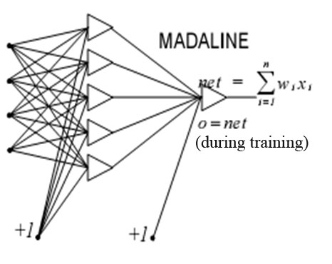
MADALINE NETWORK
MADALINE is a Multilayer Adaptive Linear Element. MADALINE was the first neural network to be applied to a real world problem. It is used in several adaptive filtering process.
“Principles of Soft Computing, 2nd Edition”
by S.N. Sivanandam & SN Deepa
Copyright © 2011 Wiley India Pvt. Ltd. All rights reserved.

Slide 16
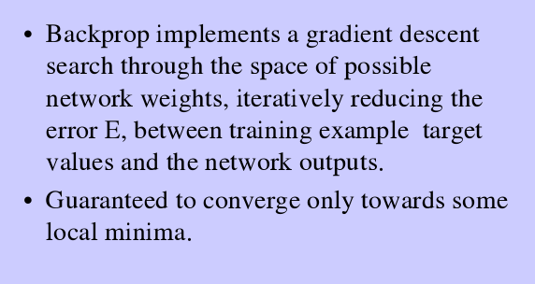
BACK PROPAGATION NETWORK
“Principles of Soft Computing, 2nd Edition”
by S.N. Sivanandam & SN Deepa
Copyright © 2011 Wiley India Pvt. Ltd. All rights reserved.

Slide 17
A training procedure which allows multilayer feed forward Neural Networks to be trained.
Can theoretically perform “any” input-output mapping.
Can learn to solve linearly inseparable problems.
“Principles of Soft Computing, 2nd Edition”
by S.N. Sivanandam & SN Deepa
Copyright © 2011 Wiley India Pvt. Ltd. All rights reserved.

Slide 18
MULTILAYER FEEDFORWARD NETWORK
Inputs
Hiddens
I₀
Outputs
h₀
I₁
o₀
h₁
I₂
o₁
h₂
Outputs
I₃
Hiddens
Inputs
“Principles of Soft Computing, 2nd Edition”
by S.N. Sivanandam & SN Deepa
Copyright © 2011 Wiley India Pvt. Ltd. All rights reserved.

Slide 19
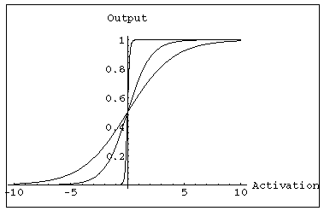
MULTILAYER FEEDFORWARD NETWORK:
ACTIVATION AND TRAINING
For feed forward networks:
  A continuous function can be
  differentiated allowing
  gradient-descent.
  Back propagation is an example of a gradient-descent technique.
  Uses sigmoid (binary or bipolar) activation function.
“Principles of Soft Computing, 2nd Edition”
by S.N. Sivanandam & SN Deepa
Copyright © 2011 Wiley India Pvt. Ltd. All rights reserved.

Slide 20
In multilayer networks, the activation function is
usually more complex than just a threshold function,
like 1/[1+exp(-x)] or even 2/[1+exp(-x)] – 1 to allow for
inhibition, etc.
“Principles of Soft Computing, 2nd Edition”
by S.N. Sivanandam & SN Deepa
Copyright © 2011 Wiley India Pvt. Ltd. All rights reserved.

Slide 21
GRADIENT DESCENT
Gradient-Descent(training_examples, η)
Each training example is a pair of the form <(x₁,…x_{n}),t> where (x₁,…,x_{n}) is the vector of input values, and t is the target output value, η is the learning rate (e.g. 0.1)
Initialize each wi to some small random value
Until the termination condition is met, Do
  Initialize each Δwi to zero
  For each <(x₁,…x_{n}),t> in training_examples Do
“Principles of Soft Computing, 2nd Edition”
by S.N. Sivanandam & SN Deepa
Copyright © 2011 Wiley India Pvt. Ltd. All rights reserved.

Slide 22
    Input the instance (x1,…,xn) to the linear unit and compute the output o
    For each linear unit weight wi Do
  Δw_{i}= Δw_{i} + η (t-o) xi
  For each linear unit weight wi Do
  w_{i}=w_{i}+Δw_{i}
“Principles of Soft Computing, 2nd Edition”
by S.N. Sivanandam & SN Deepa
Copyright © 2011 Wiley India Pvt. Ltd. All rights reserved.

Slide 23
MODES OF GRADIENT DESCENT
Batch mode : gradient descent
w=w - η ∇ED[w] over the entire data D
ED[w]=1/2Σd(t_{d}-o_{d})2
Incremental mode: gradient descent
w=w - η ∇E_{d}[w] over individual training examples d
Ed[w]=1/2 (t_{d}-o_{d})2
Incremental Gradient Descent can approximate Batch Gradient Descent arbitrarily closely if η is small enough.
“Principles of Soft Computing, 2nd Edition”
by S.N. Sivanandam & SN Deepa
Copyright © 2011 Wiley India Pvt. Ltd. All rights reserved.

Slide 24
SIGMOID ACTIVATION FUNCTION
x₀₌₁
x₁
w₁
w₀
net=Σ_{i=0}^{n} w_{i} x_{i}
o=σ(net)=1/(1+e^{-net})
w₂
x₂
Σ
o
.
.
.
w_{n}
σ(x) is the sigmoid function: 1/(1+e-x)
dσ(x)/dx= σ(x) (1- σ(x))
x_{n}
Derive gradient decent rules to train:
one sigmoid function
∂E/∂w_{i} = -Σd(td-od) od (1-od) xi
Multilayer networks of sigmoid units backpropagation
“Principles of Soft Computing, 2nd Edition”
by S.N. Sivanandam & SN Deepa
Copyright © 2011 Wiley India Pvt. Ltd. All rights reserved.

Slide 25
BACKPROPAGATION TRAINING ALGORITHM
Initialize each wi to some small random value.
Until the termination condition is met, Do
  For each training example <(x1,…xn),t> Do
    Input the instance (x1,…,xn) to the network and compute the network outputs ok
    For each output unit k
      δk=ok(1-ok)(tk-ok)
    For each hidden unit h
      δh=oh(1-oh) Σk wh,k δk
    For each network weight w,j Do
    wi,j=wi,j+Δwi,j where
      Δwi,j= η δj xi,j
“Principles of Soft Computing, 2nd Edition”
by S.N. Sivanandam & SN Deepa
Copyright © 2011 Wiley India Pvt. Ltd. All rights reserved.

Slide 26
BACKPROPAGATION
Gradient descent over entire network weight vector
Easily generalized to arbitrary directed graphs
Will find a local, not necessarily global error minimum -in practice often works well (can be invoked multiple times with different initial weights)
Often include weight momentum term
      Δwi,j(t)= η δj xi,j + α Δwi,j (t-1)
Minimizes error training examples
  Will it generalize well to unseen instances (over-fitting)?
Training can be slow typical 1000-10000 iterations (use Levenberg-Marquardt instead of gradient descent)
“Principles of Soft Computing, 2nd Edition”
by S.N. Sivanandam & SN Deepa
Copyright © 2011 Wiley India Pvt. Ltd. All rights reserved.

Slide 27
APPLICATIONS OF BACKPROPAGATION
NETWORK
Load forecasting problems in power systems.
Image processing.
Fault diagnosis and fault detection.
Gesture recognition, speech recognition.
Signature verification.
Bioinformatics.
Structural engineering design (civil).
“Principles of Soft Computing, 2nd Edition”
by S.N. Sivanandam & SN Deepa
Copyright © 2011 Wiley India Pvt. Ltd. All rights reserved.

Slide 28
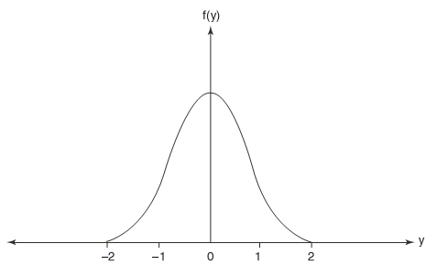

RADIAL BASIS FUCNTION NETWORK
The radial basis function (RBF) is a classification and functional approximation neural network developed by M.J.D. Powell.
The network uses the most common nonlinearities such as sigmoidal and Gaussian kernel functions.
The Gaussian functions are also used in regularization networks.
The Gaussian function is generally defined as
“Principles of Soft Computing, 2nd Edition”
by S.N. Sivanandam & SN Deepa
Copyright © 2011 Wiley India Pvt. Ltd. All rights reserved.

Slide 29
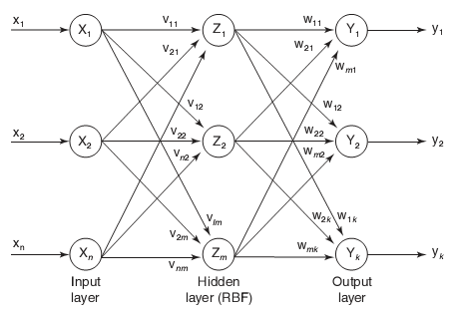
RADIAL BASIS FUCNTION NETWORK
“Principles of Soft Computing, 2nd Edition”
by S.N. Sivanandam & SN Deepa
Copyright © 2011 Wiley India Pvt. Ltd. All rights reserved.

Slide 30
SUMMARY
This chapter discussed on the several supervised learning networks like
Perceptron,
Adaline,
Madaline,
Backpropagation Network,
Radial Basis Function Network.
Apart from these mentioned above, there are several other supervised neural networks like tree neural networks, wavelet neural network, functional link neural network and so on.
“Principles of Soft Computing, 2nd Edition”
by S.N. Sivanandam & SN Deepa
Copyright © 2011 Wiley India Pvt. Ltd. All rights reserved.

